Slide 1
Exposing Image Splicing with Inconsistent Local Noise Variances
Harsh Borkar 190070027
Vineet Gala 190070072
Ayush Munjal 19D070014

Slide 2
Broad Outline and Distribution of work
Global Noise Variance Estimation - Vineet
Local Noise Variance Estimation - Harsh
Splicing Detection and Evaluation - Ayush

Slide 3
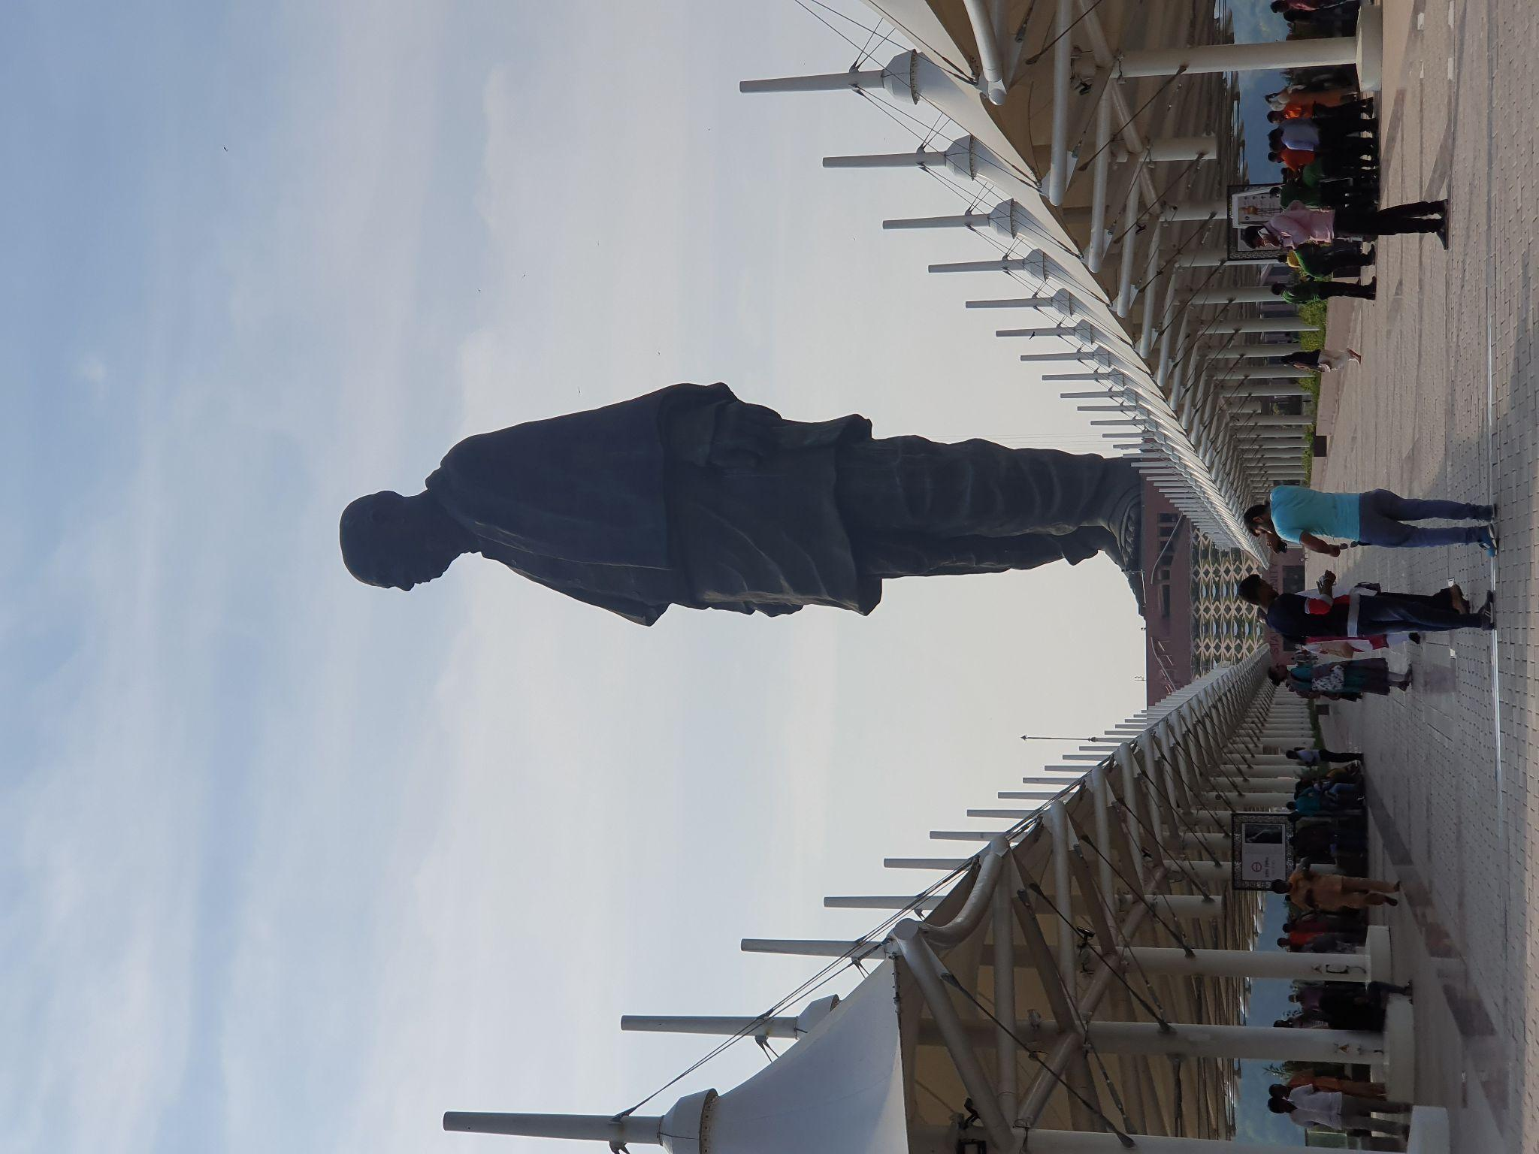


Global Noise Variance Estimation
Original Image
Est. σ² = 9.8276e-06
With AWGN: μ = 0, σ² = 0.01
Est. σ² = 0.0033
With AWGN: μ = 0, σ² = 0.02
Est. σ² = 0.0061
Observation: Estimated values were accurate to relatively compare noise magnitudes. They were off by actual values only by a constant factor

Slide 4
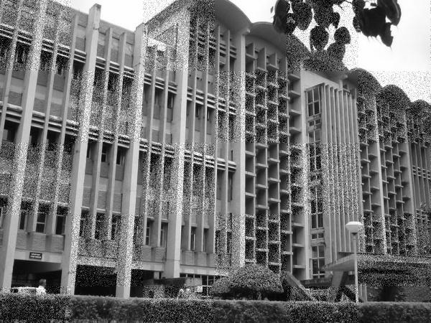
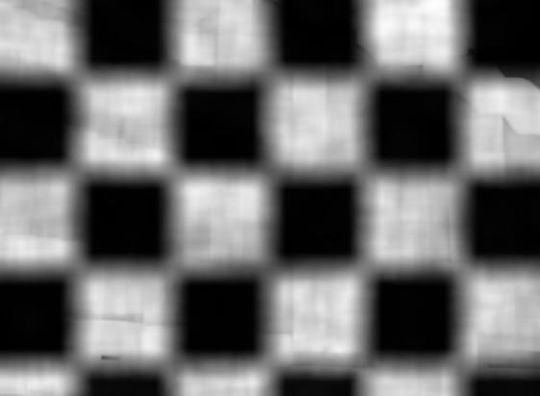
Local Noise Variance Estimation
Chequered Noise Image
Local Noise Variance
Observation: Patches with added Noise are accurately distinguished from the patches with no noise added.

Slide 5
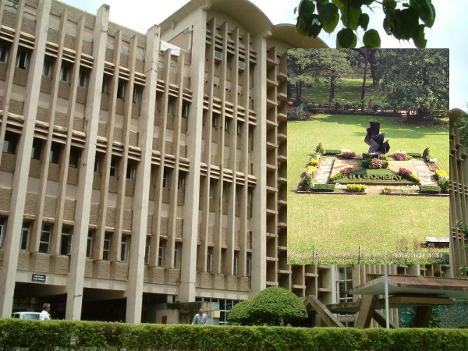
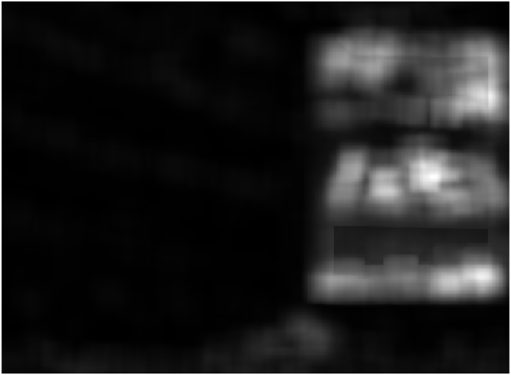
Local Noise Variance Estimation
Spliced Image
Local Noise Variance
Observation: The difference between the noise variances of the spliced patches and the original image can be seen.
Notes:
Body font - Open Sans, size - 20, Colour - default
Kuch exceptions ho toh change kar sakte hai

Slide 6


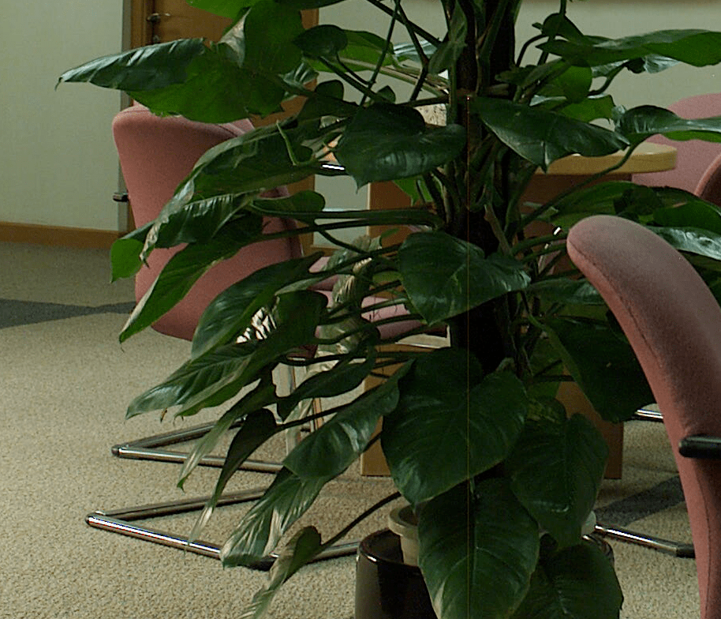
Different noise variance for different camera models
Average local noise variance = 119.4
Average local noise variance = 115.6
Average local noise variance = 1.11

Slide 7
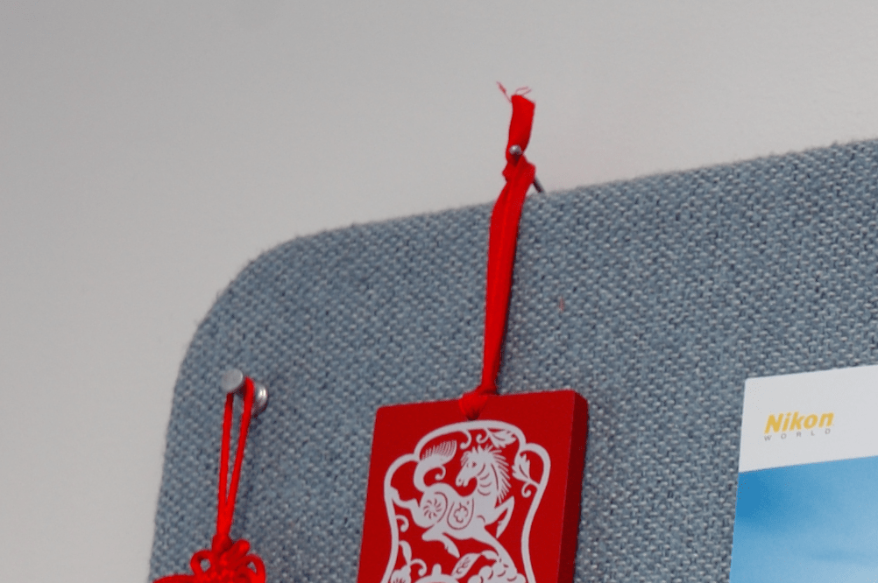

Image Splicing Detection
Images taken using different cameras thus having different noise variance

Slide 8
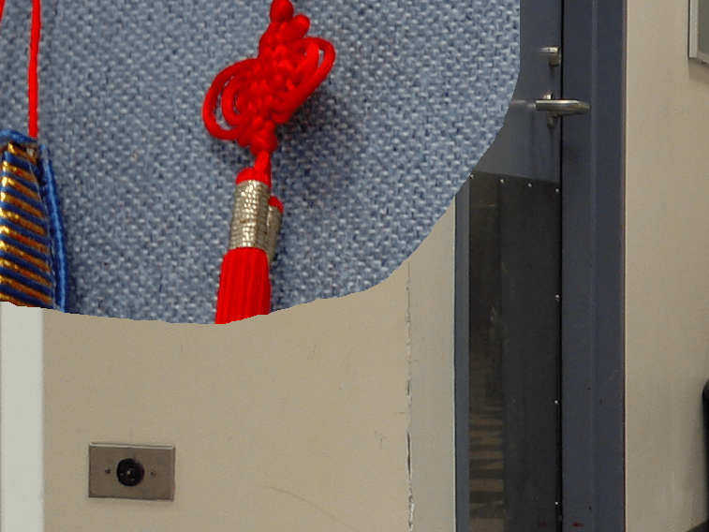
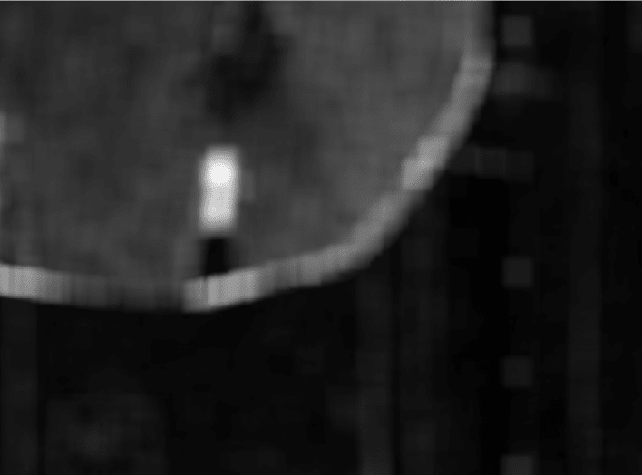
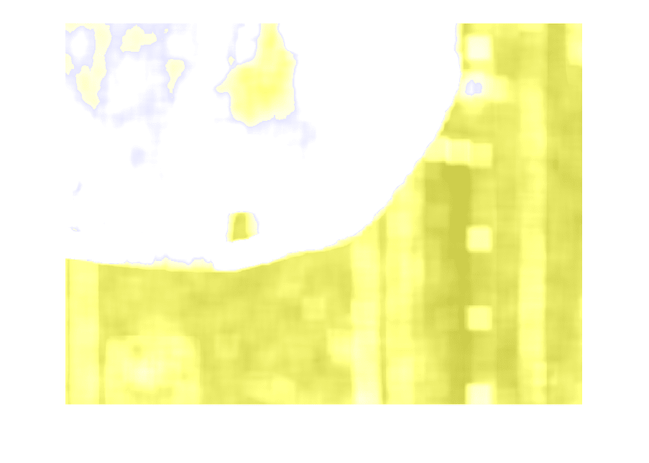
Spliced Image
Local Noise Variance
Segmentation

Slide 9
Comparison with related work
Disadvantages
It assumes the noise to be zero mean white Gaussian process that is additive and independent of the image
It does not give good results for JPEG compressed images
It assumes intrinsic noise variances are similar across different locations within the original image
It assumes that different images have different intrinsic noise variance
Advantages
The running time of this algorithm is much less than other algorithms for image splicing detection
It identifies spliced regions with higher accuracy down to the pixel level

Slide 10
THANK YOU

Slide 11
APPENDIX

Slide 12
